Slide 1
SMesh Mega2
V2

Slide 2
Objectives
Describe the electronics and construction where they different with build standard 1
Mega is
  LiIon battery
  PM sensor, BME but no INA
  Solar charging option
  RPi Z Logger with shutdown switch included
It is useful for
  Prototype for drone sensor
  Diagnostics in the field and lab
  Short duration deployments
INA was needed to monitor
12V battery power. Meshtastic
has built-in monitor for LiIon.

Slide 3
Battery Capacity and Voltage
LiIon batteries are about 10 Ah and 3.7 to 4.2 V
Battery life in hours is Capacity in Ah divided by average current drawn from battery in amperes.
The Meshtastic radio/computer/display and the BME are 3.7V
The PM sensor and RPi, and battery charging from Meshtastic, require 5V
The battery supplies 3.7V and a 3.7 → 5V DC-DC converter is used to provide 5V.
  Switching power supply has 90%+ efficiency
  Input current does not equal output current
  More about switchers <here>

Slide 4
Solar Charger
Mega’s battery is somewhat undersized:
  10 Ah * 3 LiIon batteries = 30 Ah
  Average current draw is 0.5 A with the logger on
  It can run for almost 3 days
Solar panels can extend battery life
Connect via a schottky diode to the 5V Meshtastic input and there is a battery charger on the Meshtastic which prevents overcharging.
More about solar chargers <here>

Slide 5
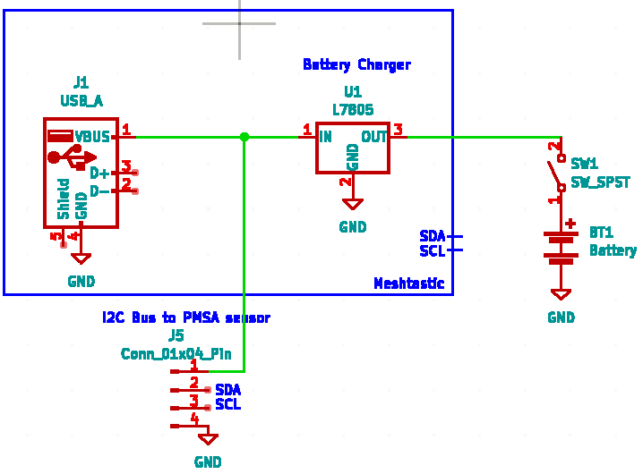
Mega: PM sensor works only when powered by USB

Slide 6
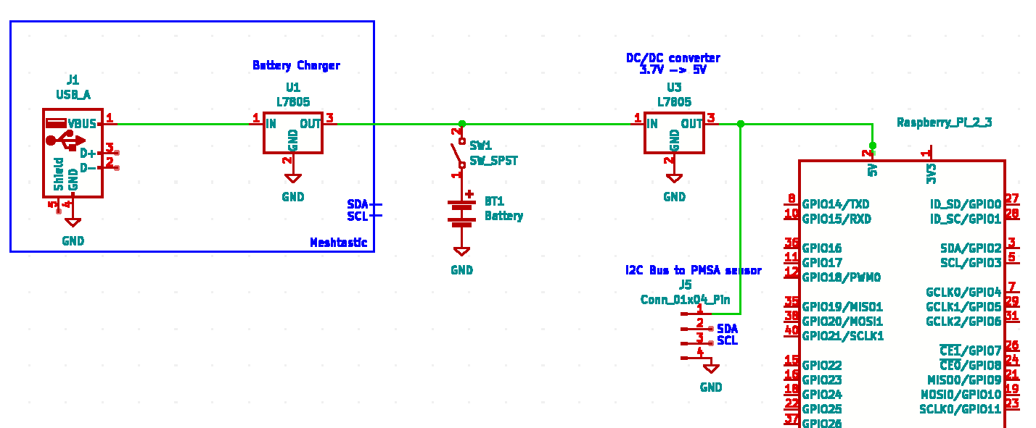
Add RPi, 5V power for PM sensor
Can’t charge battery
Possibly too much current in the DC-DC converter

Slide 7
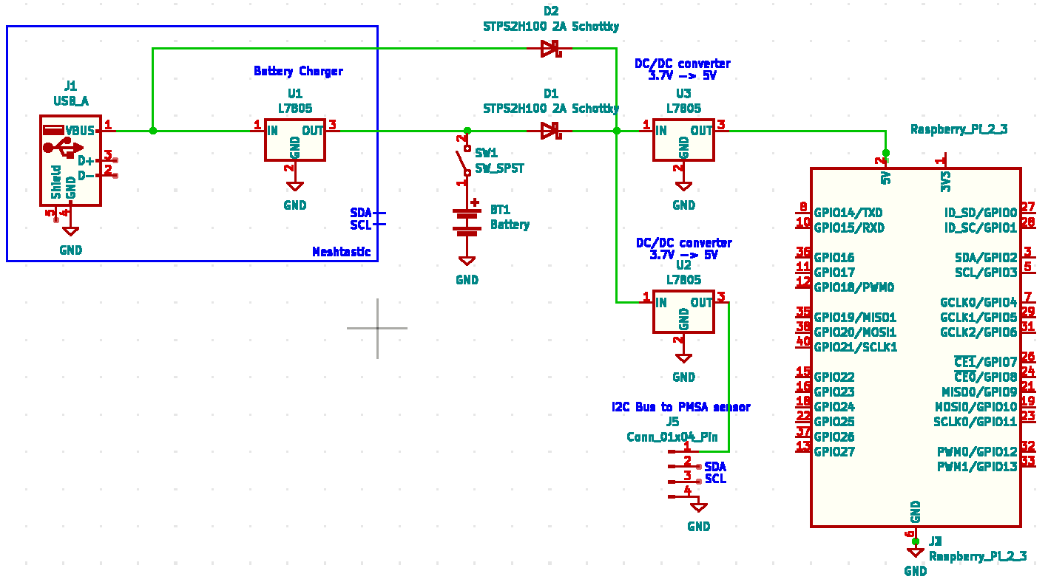
Charges battery when USB connected and SW1 on
PM sensor gets 5V
Adequate current handling in DC-DC converters

Slide 8
Schottky Diodes
We use them for lower forward voltage drop, which has lower power loss.
The two diodes we use form a “wired or” circuit. Power for the 5V DC-DC converters comes from either the battery or the USB .. without connecting them together.
More information about “Schottkys” is <here>

Slide 9
Dipole Antenna
Best to always connect an antenna when powering up a Meshtastic, as no antenna has been known to occasionally destroy the transmitter.
The simplest form of an antenna is a dipole. One side becomes positive in voltage, one side becomes negative as the electromagnetic wave passes through on receive, or is generated on transmit
Wire becomes +
Wire becomes -
Cable to radio

Slide 10
Ground Plane antenna
Also possible to reflect one side over a ground plane, which acts like a mirror.
In the plane above the ground, it
behaves like a dipole
In the plane below the ground, no
antenna is visible.
---Ground Plane --
Cable to radio

Slide 11
Approximation of ground plane
Just a wire coming from the radio serves as the monopole, while the radio and battery themselves form the ground plane, albeit imperfect
Instead of straight wires, the antenna can be made physically shorter by coiling the wire.

Slide 12
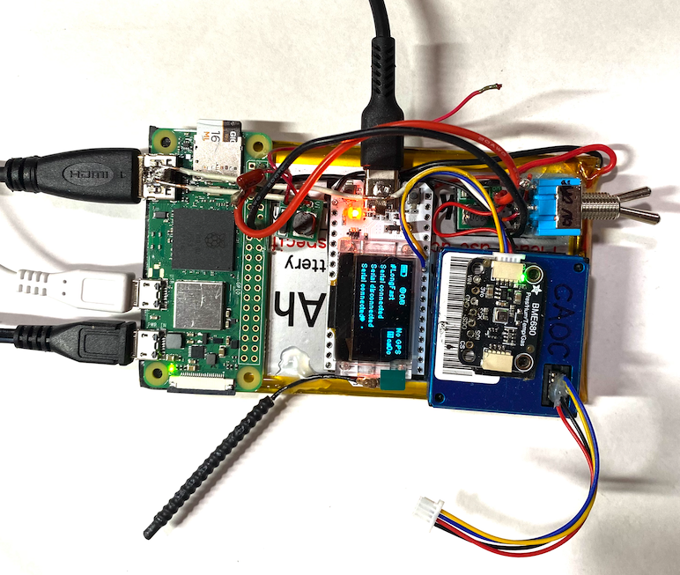
Mega2
Shutdown
switch
Battery
switch
Antenna

Slide 13
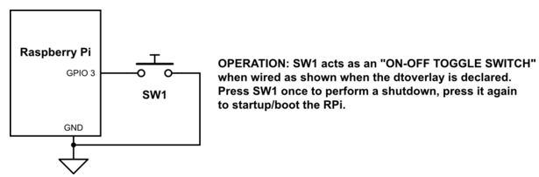
The shutdown switch
The RPi, and most cached file systems, require notification before shutdown
  Directories and files are cached in RAM for speed
  At shutdown, the OS writes them to disk
Capacitor reduces
sensitivity to
local electrical noise
sudo nano /boot/firmware/config.txt
dtoverlay=gpio-shutdown,gpio_pin=3
More info about the shutdown switch

